Slide 1
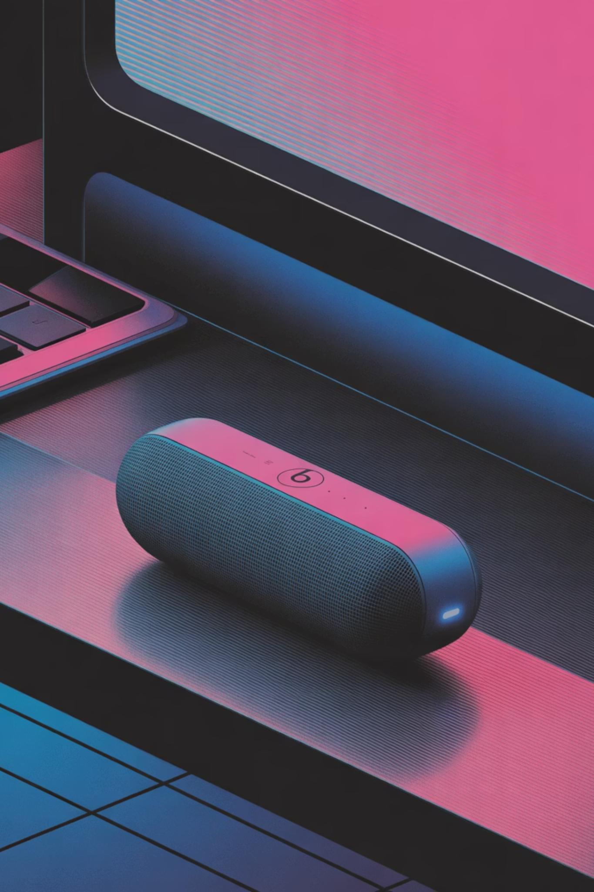
Beats Pill: Executive Presentation
Customer Review Analysis | Jordyn Miller | March 12, 2026

Slide 2




Strategic Recommendation
Launch with Targeted Improvements to Win the Category
Beats achieves ~85% positive sentiment, confirming strong product-market fit in a mature, competitive category.
Positive·85%
·
Neutral·9%
Negative·6%
·
Close Competitive Gaps
Compete at the Top
Improve EQ/app control, high-volume audio stability, and battery reliability.
With targeted improvements, Beats Pill can challenge category leaders directly.

Slide 3
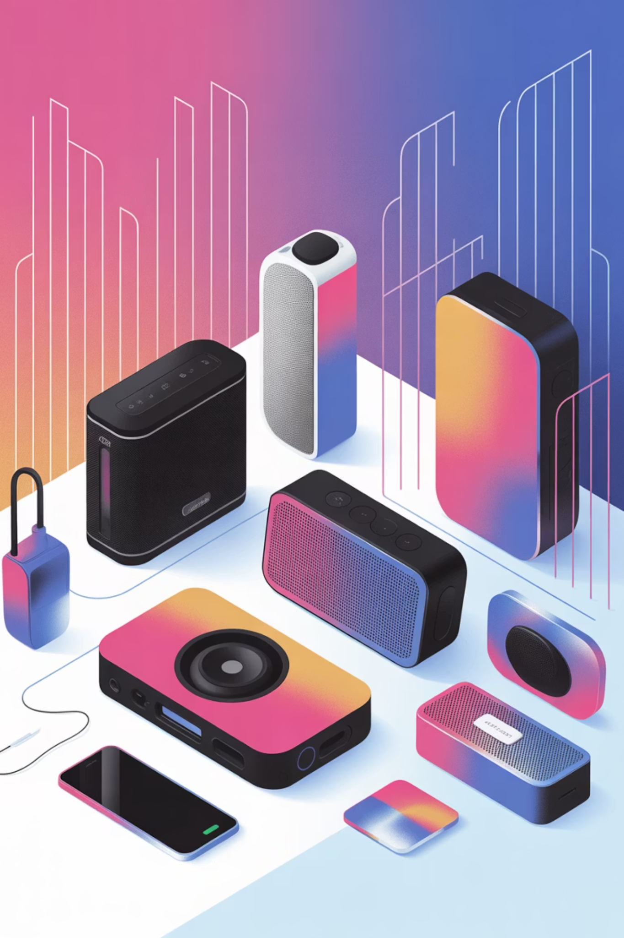
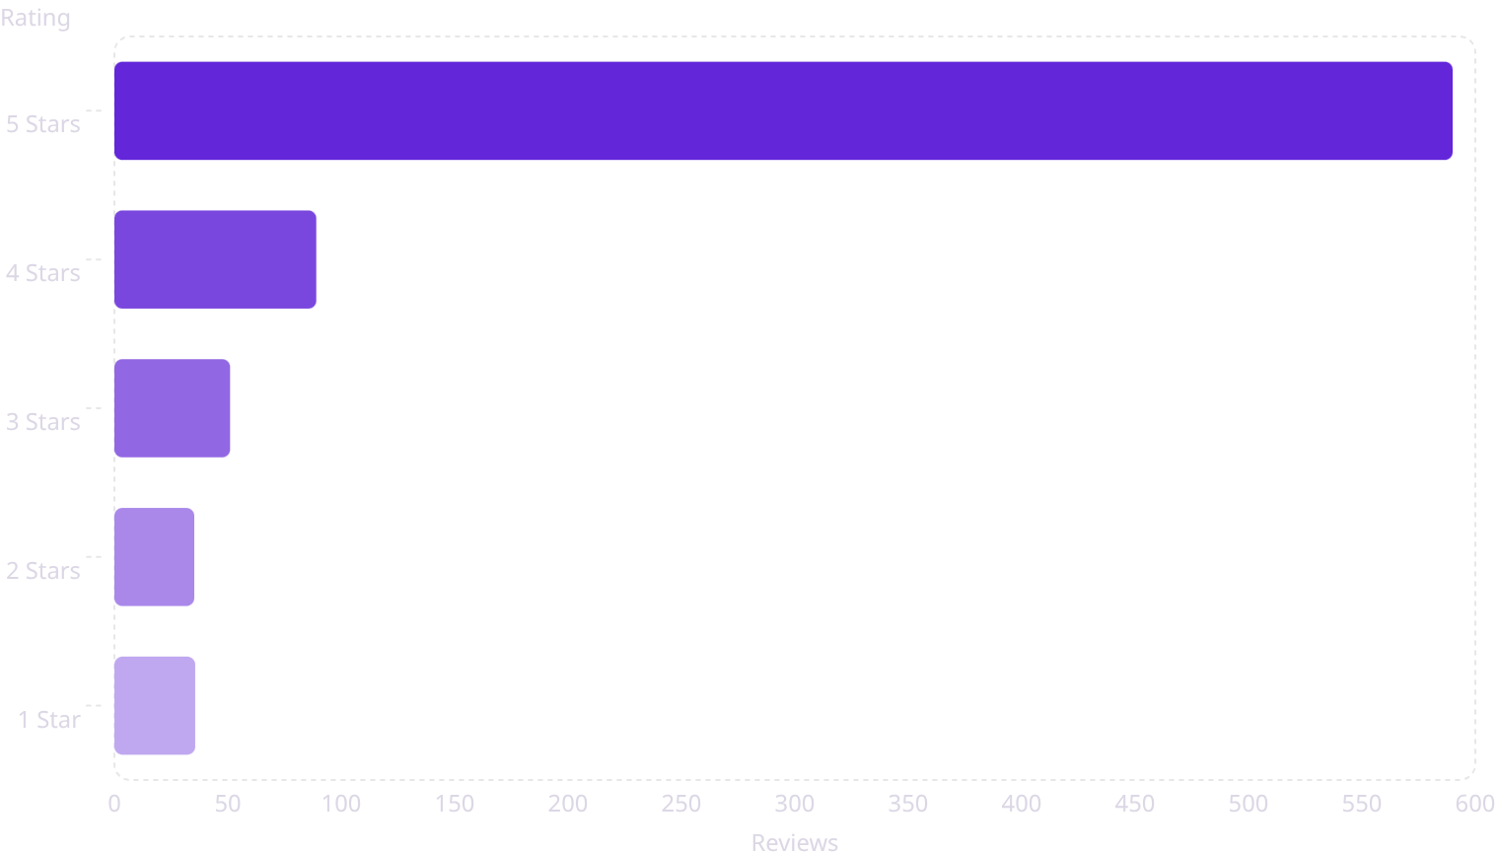
Market Context
A High-Satisfaction Category Where Differentiation Matters
Across 823 reviews, overall sentiment is overwhelmingly positive — 5-star ratings dominate the category, signaling consistently strong baseline performance.
Because all major brands perform well, small feature differences strongly influence brand choice. Brands win through ecosystem integration, design, durability, and audio tuning — not raw performance alone.

Slide 4

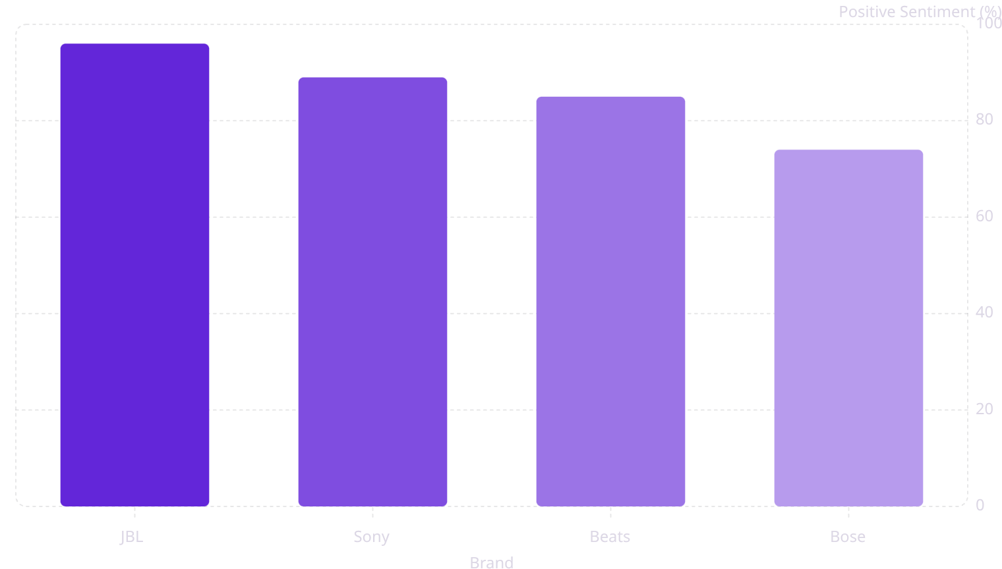
Competitive Position
Beats Performs Strongly, but JBL Sets the Benchmark
Beats ranks among the top brands in customer satisfaction. JBL leads with ~96% positive sentiment — a clear target. Sony and Bose show more mixed experiences, representing an opportunity for Beats to capture dissatisfied customers from those brands.

Slide 5
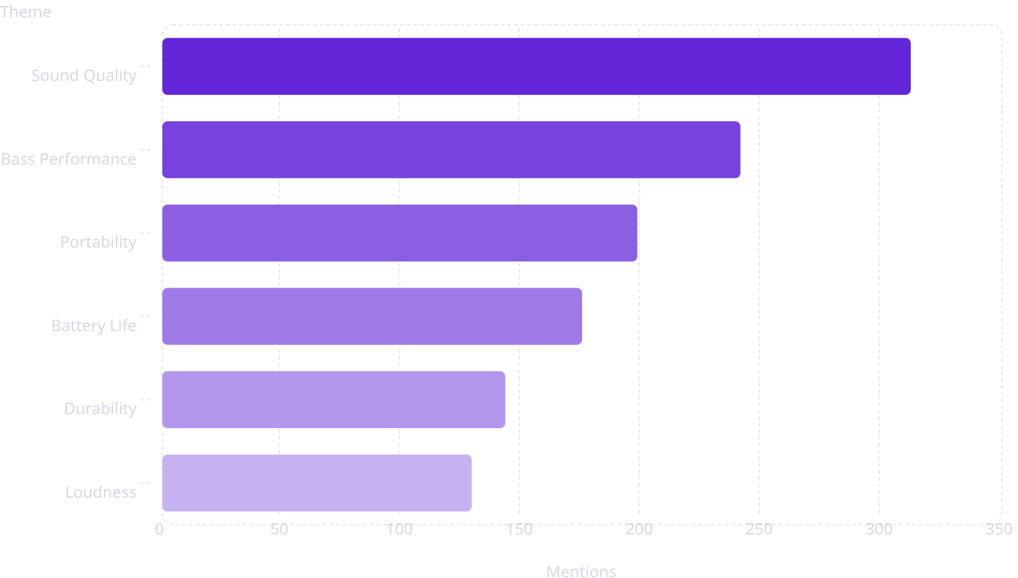
Customer Priorities
Sound Quality, Portability, and Battery Life Drive Purchase Decisions
Customer conversations center on audio performance above all else — sound quality and bass are the top two discussed features by a wide margin.
Loudness and bass strongly influence satisfaction scores
Portability and durability are critical for outdoor and travel use cases
Battery life expectations are elevated by mobile-first listening habits

Slide 6
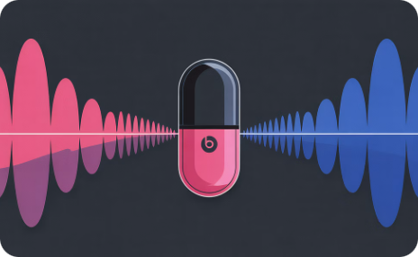
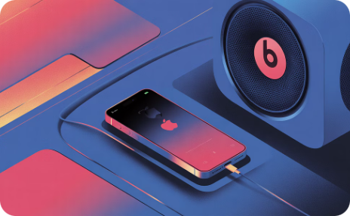
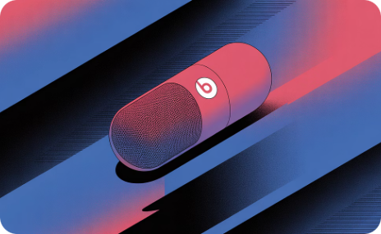
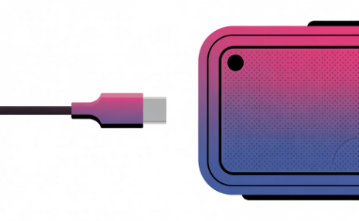
Where Beats Wins
Beats Differentiates Through Design and Ecosystem Integration
Premium Audio Performance
Apple Ecosystem Integration
Premium Design & Build
Versatile Feature Set
Speakerphone capability and USB-C audio add practical daily value beyond basic playback.
Strong bass and clear, full sound output for its compact size — a core differentiator in the category.
Seamless pairing with Apple devices delivers a frictionless, familiar experience for the core customer base.
Distinctive aesthetic and quality construction strengthen brand perception and justify premium positioning.

Slide 7








Product Improvements
Four Improvements Needed to Match Category Leaders
Customer feedback consistently identifies these gaps as the most important barriers to closing the distance with JBL.
EQ & App Control
High-Volume Stability
No dedicated companion app limits sound customization. Users want control over their listening profile.
Bass distortion at maximum volume reduces perceived audio quality — a direct comparison point vs. JBL.
Battery Reliability
Connectivity Polish
Performance inconsistency under heavy use erodes trust. Real-world reliability must match spec-sheet claims.
Minor multi-device switching issues create friction. Seamless connectivity is table stakes for premium buyers.

Slide 8

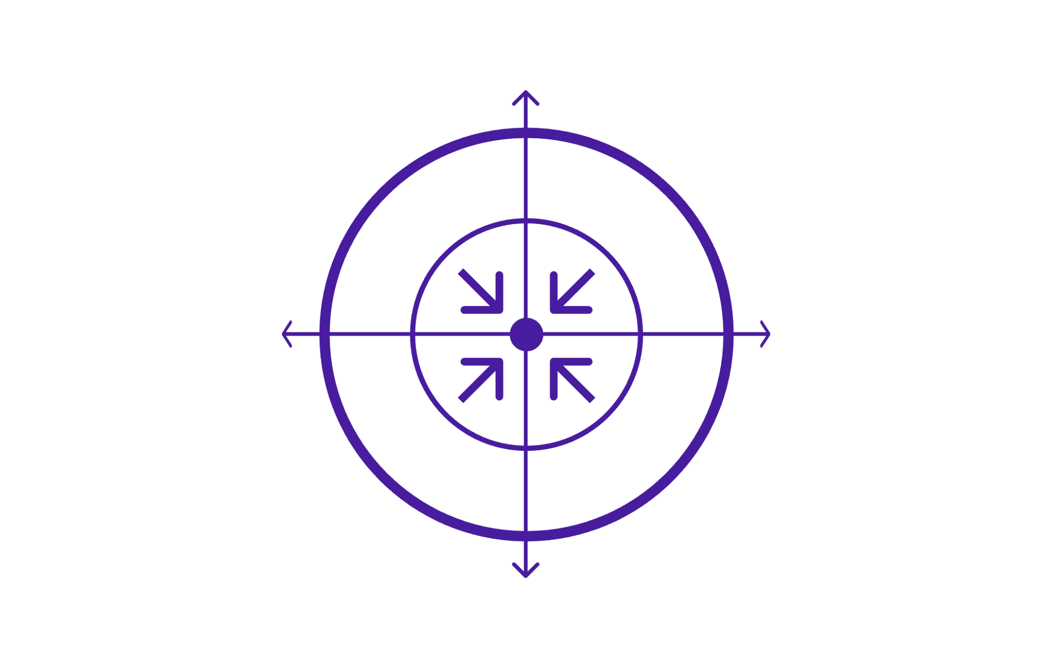
Launch Strategy
Target the Apple Lifestyle Consumer with a Competitive Premium Position
Target Audience
Pricing: $149–$199
Young, tech-savvy Apple ecosystem users seeking portable audio for travel and social use.
Competitive with top rivals while maintaining Beats' premium brand positioning.
Go-to-Market
Strategic retail placement, digital channels, and influencer-led lifestyle campaigns.
Launch Phase Strategic Impact
Target Audience
Pricing & Position
Product Improvements
Launch Channels

